Slide 1


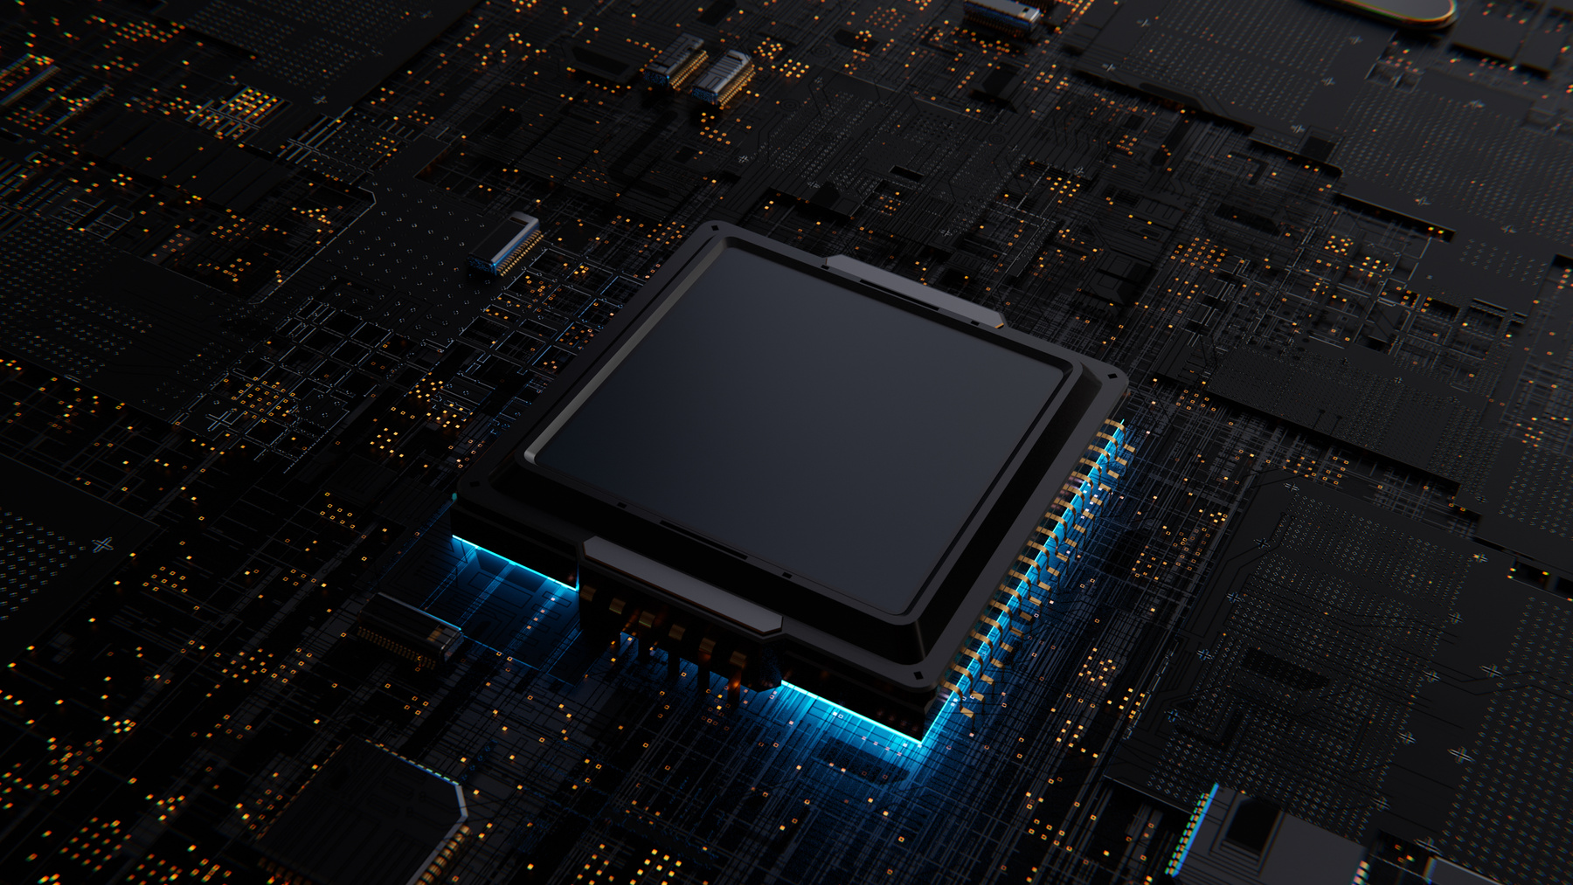
Umer Farooq — Muhammad Irtaza Khan
Neural Network Acceleration on GPUs
MNIST Classification

Slide 2
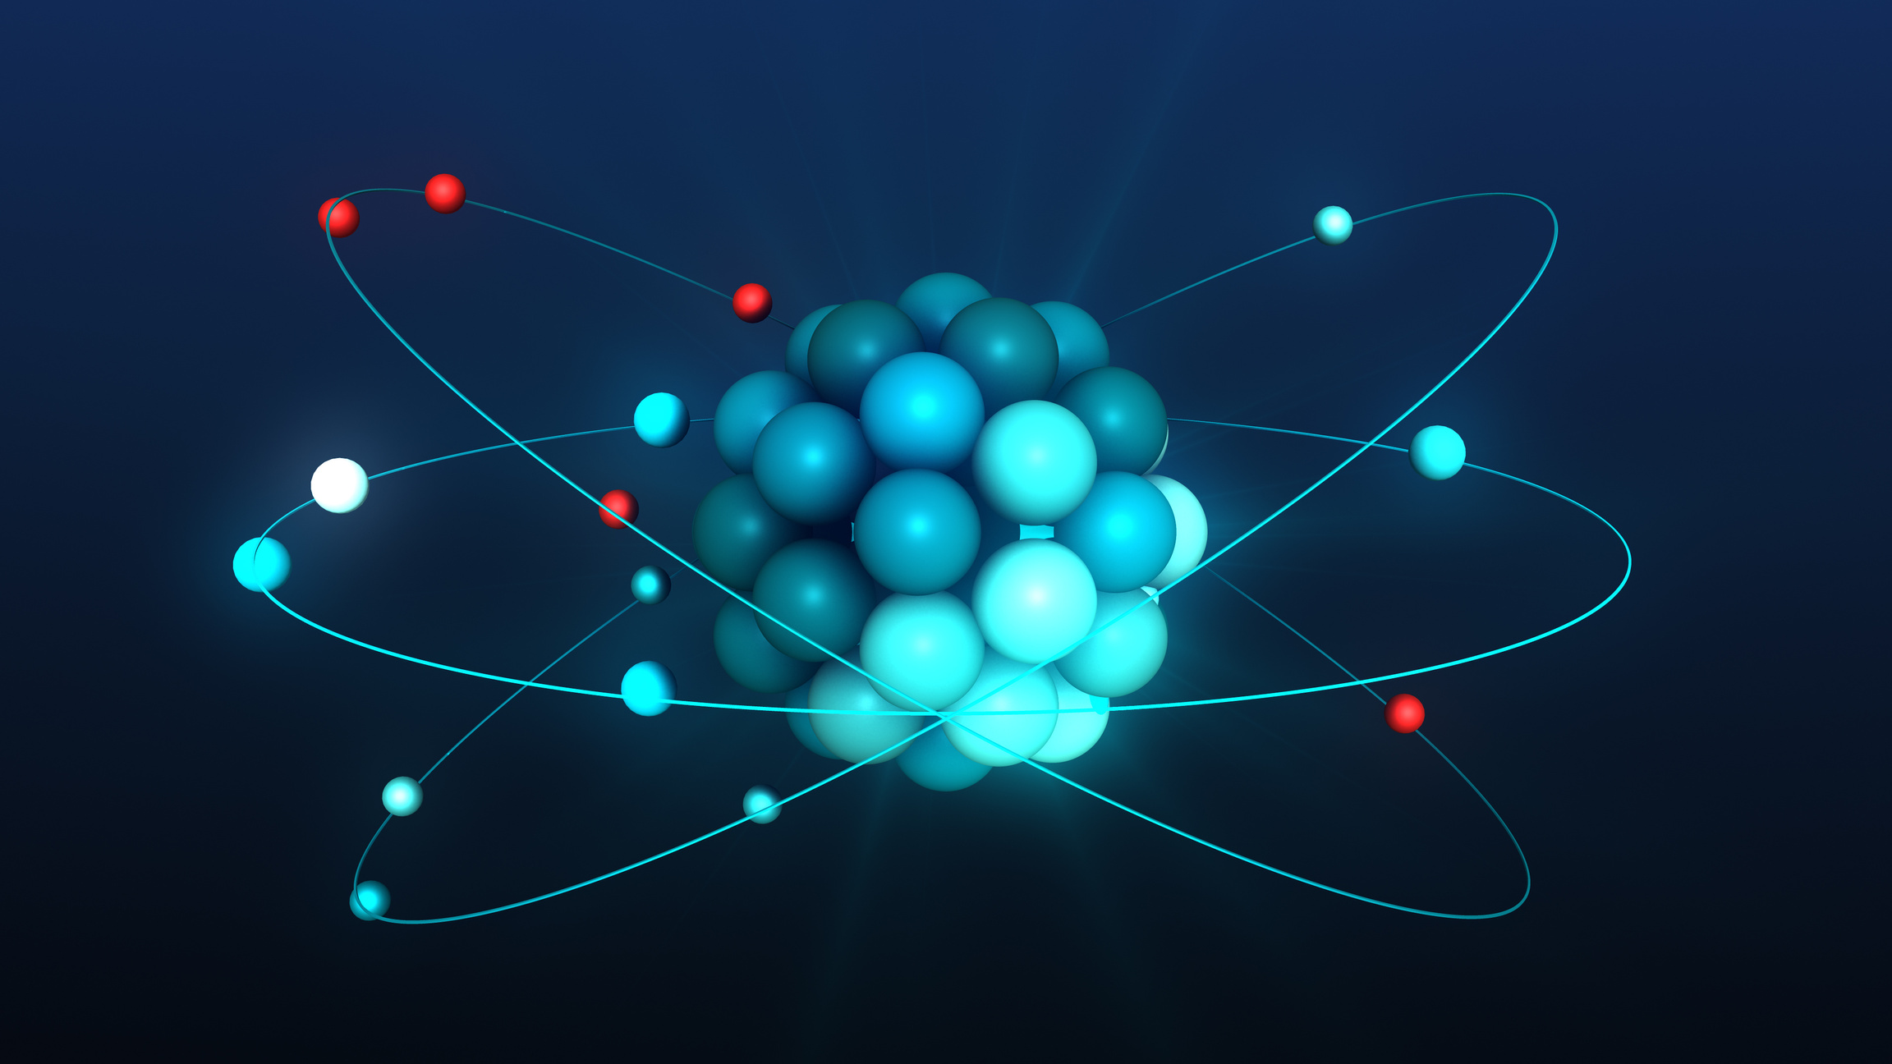
Project Objective
Accelerate MNIST Neural Network using GPU.
Learn CUDA, HPC, and Parallel Programming.
Optimize from CPU to GPU — Step by Step.

Slide 3

Technologies Used
CUDA Toolkit
OpenACC
NVIDIA GPU (Tensor Cores)
MNIST Dataset
Makefile
NVCC
NSight Compute

Slide 4
Version Evolution
Version
V1
V2
V3
V4
V5
Description
Sequential CPU Version
Naive CUDA Parallelism
Optimized CUDA
Tensor Core Acceleration
OpenACC Parallelism

Slide 5

V3 Optimizations
- Optimized kernel launch configuration.
- Improved occupancy and memory usage.
- Reduced communication overhead.
- Efficient memory hierarchy utilization.
- Utilized Cuda Streams
- Utilized Pinned Memory
- Initialization shifted to kernel side
- Combined multiple small kernels
- Utilized Shared Memory
- Used Optimized Compiler Flags

Slide 6


V4 & V5 Highlights
V4: Tensor Core Optimization
Matrix Multiplication via Tensor Cores
Maximize GPU compute power.
V5: OpenACC Implementation
Directive-based parallelism.
Quick porting, hardware abstraction.

Slide 7

Performance Analysis

Slide 8


Total Training Time: Speed Up Analysis

Slide 9
Conclusion
GPU acceleration significantly improves training time
Manual optimization (V3) gave speedup but required effort
Tensor Cores (V4) require precise handling
OpenACC (V5) achieved best performance and developer efficiency
Future work: Fix V4 issues for even higher speedups

